Slide 1
COMPUTER NETWORKS
SESSION 03
Network layer1 – data transfer
Santoso Budijono

Slide 2
Learning outcomes
LO 1: Describe basic structures of network
LO 2: Explain basic concepts of network

Slide 3
Outline
Network Layer Services
Packet Switching
Network Performance
IPv4
IPv6

Slide 4
Network layer services
1. Packetizing
    Encapsulating the payload (data received from the upper layer) in a network-layer packet at the source and decapsulating the payload from the network-layer packet at the destination
2. Routing
    The network layer is responsible for routing a network-layer packet from its source to the destination. A physical network is a combination of networks (LANs and WANs) and routers that connect them
3. Error Control
    Discussed error detection and correction. Although error control also can be implemented in the network layer, the designers of the network layer in the Internet ignored this issue for the data being carried by the network layer. One reason for this decision is the fact that the packet in the network layer may be fragmented at each router, which makes error checking at this layer inefficient.

Slide 5
Network layer services
4. Flow Control
    Regulates the amount of data a source can send without overwhelming the receiver. If the upper layer at the source computer produces data faster than the upper layer at the destination computer can consume it, the receiver will be overwhelmed with data. To control the flow of data, the receiver needs to send some feedback to the sender to inform the latter that it is overwhelmed with data
5. Congestion Control
    Congestion in the network layer is a situation in which too many datagrams are present in an area of the Internet. Congestion may occur if the number of datagrams sent by source computers is beyond the capacity of the network or routers. In this situation, some routers may drop some of the datagrams. However, as more datagrams are dropped, the situation may become worse because, due to the error-control mechanism at the upper layers, the sender may send duplicates of the lost packets. If the congestion continues, sometimes a situation may reach a point where the system collapses and no datagrams are delivered.

Slide 6
Network layer services
6. Quality of Services
    As the Internet has allowed new applications such as multimedia communication (in particular real-time communication of audio and video), the quality of service (QoS) of the communication has become more and more important. The Internet has thrived by providing better quality of service to support these applications. However, to keep the network layer untouched, these provisions are mostly implemented in the upper layer.
7. Security
    The network layer was designed with no security provision. Today, however, security is a big concern. To provide security for a connectionless network layer, we need to have another virtual level that changes the connectionless service to a connection-oriented service. This virtual layer, called IPSec

Slide 7
Packet switching
In data communications switching techniques are divided into two broad categories, circuit switching and packet switching, only packet switching is used at the network layer because the unit of data at this layer is a packet.
At the network layer, a message from the upper layer is divided into manageable packets and each packet is sent through the network. The source of the message sends the packets one by one; the destination of the message receives the packets one by one. The destination waits for all packets belonging to the same message to arrive before delivering the message to the upper layer.
The connecting devices in a packet-switched network still need to decide how to route the packets to the final destination.

Slide 8
Network performance
delay
Transmission Delay
A source host or a router cannot send a packet instantaneously. A sender needs to put the bits in a packet on the line one by one. If the first bit of the packet is put on the line at time t1 and the last bit is put on the line at time t2, transmission delay of the packet is (t2 − t1). Definitely, the transmission delay is longer for a longer packet and shorter if the sender can transmit faster. In other words, the transmission delay is
Delaytr = (packet length) / (transmission rate)

Slide 9
Network performance
delay
Propagation Delay
Propagation delay is the time it takes for a bit to travel from point A to point B in the transmission media. The propagation delay for a packet switched network depends on the propagation delay of each network (LAN or WAN). The propagation delay depends on the propagation speed of the media, which is 3 × 108 m/s in a vacuum and normally much less in a wired medium; it also depends on the distance of the link. In other words, propagation delay is
Delaypg = (distance) / (propagation speed)

Slide 10
Network performance
delay
Queuing Delay
Queuing delay can normally happen in a router. A router has an input queue connected to each of its input ports to store packets waiting to be processed; the router also has an output queue connected to each of its output ports to store packets waiting to be transmitted. The queuing delay for a packet in a router is measured as the time a packet waits in the input queue and output queue of a router. We can compare the situation with a busy airport. Some planes may need to wait to get the landing band (input delay); some planes may need to wait to get the departure band (output delay).
Delayqu = time a packet waits in input and output queues in a router

Slide 11
Network performance
delay
Total Delay
Assuming equal delays for the sender, routers, and receiver, the total delay (source-to-destination delay) a packet encounters can be calculated if we know the number of routers, n, in the whole path.
if we have n routers, we have (n + 1) links. Therefore, we have (n + 1) transmission delays related to n routers and the source, (n + 1) propagation delays related to (n + 1) links, (n + 1) processing delays related to n routers and the destination, and only n queuing delays related to n routers.
Total delay = (n + 1) (delaytr + delaypg + delaypr) + (n) (delayqu)

Slide 12
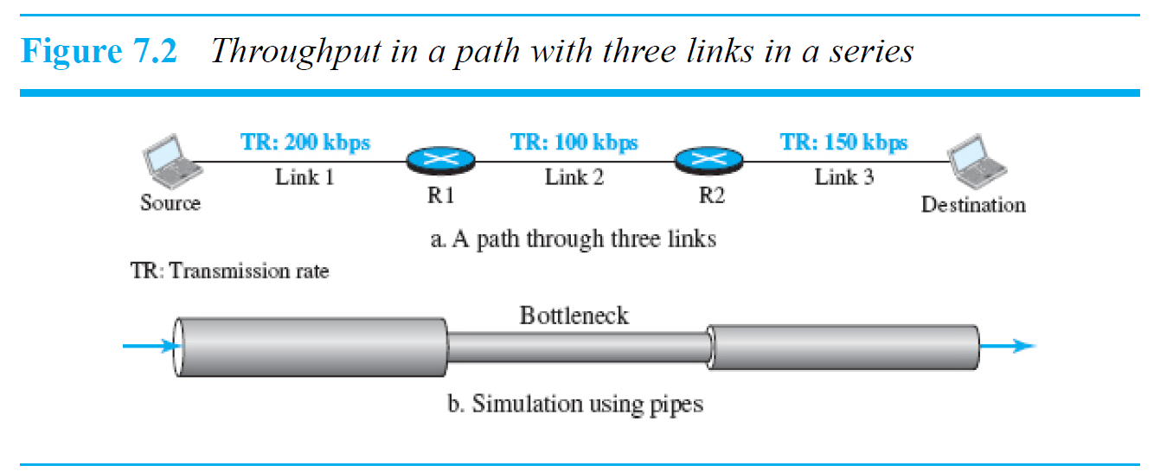
Network performance
throughput
Throughput at any point in a network is defined as the number of bits passing through the point in a second, which is actually the transmission rate of data at that point. In a path from source to destination, a packet may pass through several links (networks), each with a different transmission rate. How, then, can we determine the throughput of the whole path? To see the situation, assume that we have three links, each with a different transmission rate, as shown in below
Throughput = minimum {TR1, TR2, …, TRn}
Forouzan 6th edition , chapter 7

Slide 13
Network performance
Packet loss
Another issue that severely affects the performance of communication is the number of packets lost during transmission. When a router receives a packet while processing another packet, the received packet needs to be stored in the input buffer waiting for its turn. A router, however, has an input buffer with a limited size. A time may come when the buffer is full and the next packet needs to be dropped.
The effect of packet loss on the Internet network layer is that the packet needs to be re-sent, which in turn may create overflow and cause more packet loss. A lot of theoretical studies have been done in queuing theory to prevent the overflow of queues and prevent packet loss.

Slide 14
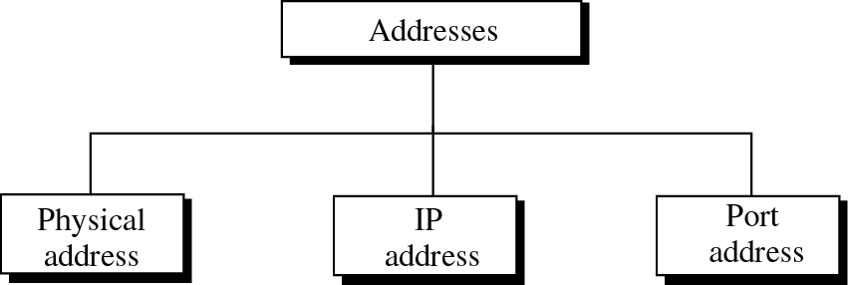
addressing

Slide 15
addressing
PHYSICAL ADDRESS
MAC Addresses are split in two:
  1st Half is the OUI
  2nd Half is Vendor Assigned
Format: oktet
44-AB-5F-DF-C1-FB

Slide 16
addressing
LOGICAL ADDRESS
IP Address
  A logical address used in TCP/IP networking for identifying a host in the network
IP Address Characteristics
  An IP address is 32 bits in size, unique, grouped into four 8-bit octets
  Octets are separated by decimal points
Network Administrator
  IP addresses are assigned by a network administrator according to an organization’s valid IP address range.
ICANN (Internet Corporation for Assigned Names & Numbers)
  Central authority on Internet addresses and names.
  A group of IP addresses must be obtained via an ISP.

Slide 17
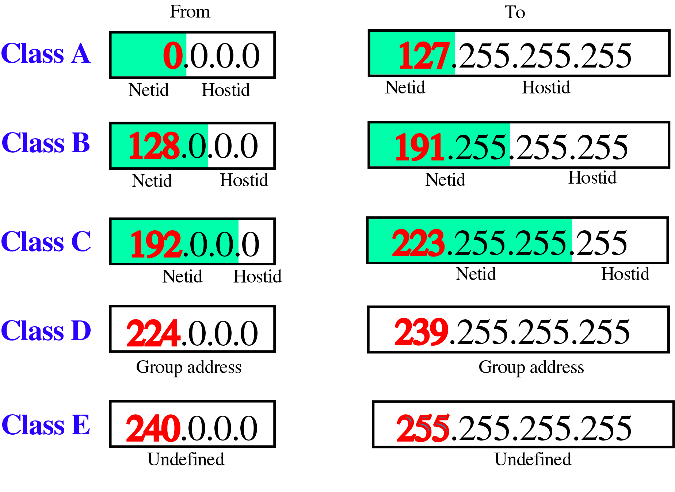
addressing
LOGICAL ADDRESS (CLASSFULL ADDRESSES)

Slide 18
addressing
SPECIAL IP ADDRESS
Some IP address numbers are reserved for special functions.
IP address whose numeric value is the highest value in the network (host bits all equal to one) is a broadcast address.
IP addresses with first octet of 127 such as 127.0.0.1 is a loopback IP used to test local workstation communication
IP addresses ending in “1” are typically reserved for gateway.

Slide 19
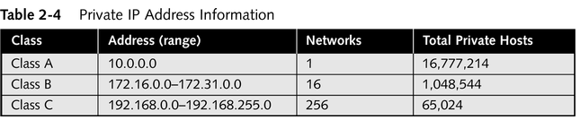
addressing
PRIVATE & PUBLIC IP ADDRESS
A number of blocks in each class are assigned for private use. They are not recognized globally
Several techniques exist to hide internal network IP addresses from outside view
Any organization can use these addresses provide they adhere to the rules
All connectivity to an Internet host must be provided by a Network Address Translator
PRIVATE IP ADDRESS
  10.0.0.0 - 10.255.255.255
    A single Class A network
  172.16.0.0 - 172.31.255.255
    Sixteen continuous Class B Networks
  192.168.0.0 - 192.168.255.255
    256 contiguous Class C networks

Slide 20
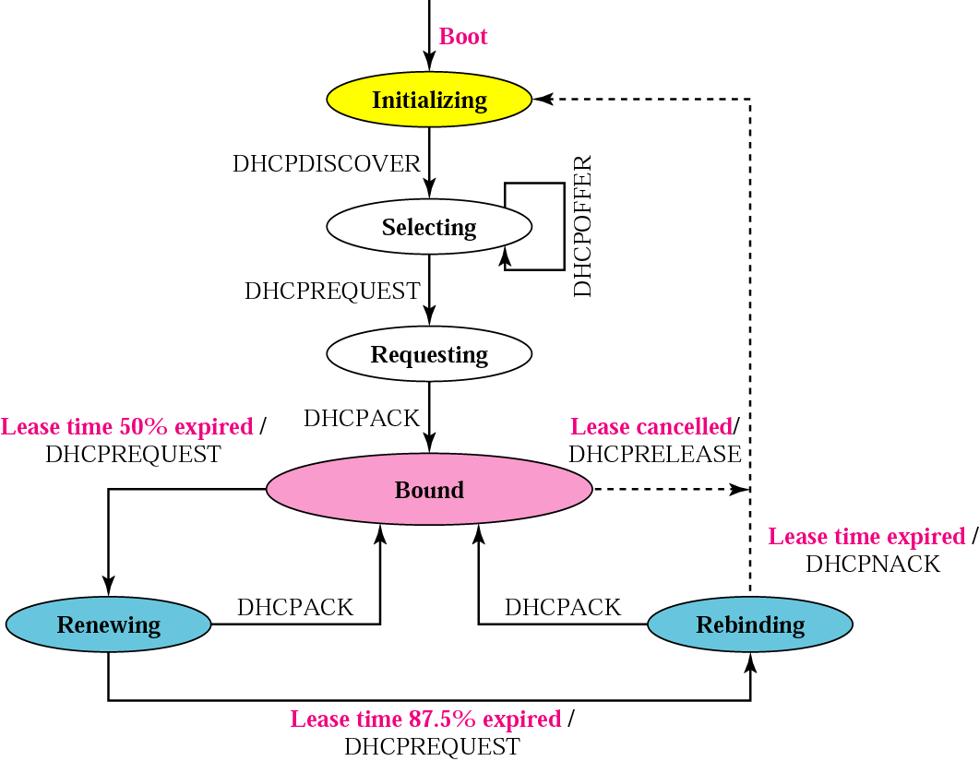
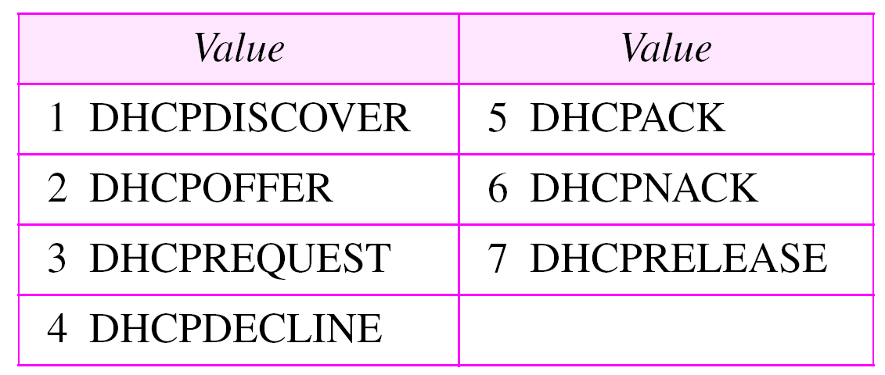
addressing
DHCP
DHCP
Give IP address to device automatically
Mapping Layer 2 address with layer 3 address, save IP address and MAC address on server DHCP database

Slide 21
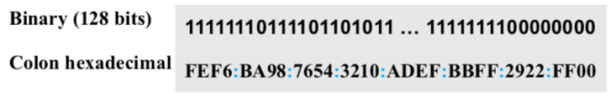

addressing
IPV6
Internet Protocol version 6 (IPv6) or IP new generation (IPng), was a proposal to augment the address space of IPv4 and at the same time redesign the format of the IP packet and revise some auxiliary protocols such as ICMP.
The main changes needed in the new protocol were as follows: larger address space, better header format, new options, allowance for extension, support for resource allocation, and support for more security.
IPv6 address is 128 bits or 16 bytes (octets) long, 4 times the address length in IPv4
Binary notation is used when the addresses are stored in a computer. The colon hexadecimal notation (or colon hex for short) divides the address into eight sections, each made of four hexadecimal digits separated by colons.
Mixed representation of an IPv6 address: colon hex and dotted-decimal notation.
IPv6 allows slash or CIDR notation.
  example, the following shows how we can define a prefix of 60 bits using CIDR.

Slide 22
ADDRESSING
IPV6 VS IPV4
The following shows a quick comparison between the options used in IPv4 and the options used in IPv6 (as extension headers) :
The no-operation and end-of-option options in IPv4 are replaced by Pad1 and PadN options in IPv6.
The record route option is not implemented in IPv6 because it was not used.
The timestamp option is not implemented because it was not used.
The source route option is called the source route extension header in
IPv6.
The fragmentation fields in the base header section of IPv4 have moved to the fragmentation extension header in IPv6.
The authentication extension header is new in IPv6.
The encrypted security payload extension header is new in IPv6.

Slide 23
Review Questions
What is the difference of ESS and AP at Wireless configuration ?
What is function of ARP? And if ARP down what happened in networks ?
What is RARP function ? And what is the connection of RARP and DHCP ?

Slide 24
References
Forouzan, B. A. (2021). Data Communications and Networking with TCP/IP Protocol Suite. 6th Ed. New York: McGraw-Hill. ISBN: 978-1-26-436335-3. Chapter 7.

Slide 25
Thank you
December 2024

